Slide 1

OpenGL ES Define and Draw 2d Shapes Chapters 2 & 3
Eng. Basma Hassan
Eng. Samar Shaban

Slide 2

Define Shape: Vertices
To draw any object, you must define its coordinates in three-dimensional space.
In OpenGL ES, the typical way to do this is to define a vertex array of floating point numbers for the coordinates.
Coordinates of the shape are defined in a counterclockwise order.
For maximum efficiency, coordinates are written into a ByteBuffer, that is passed into the OpenGL ES graphics pipeline for processing.

Slide 3
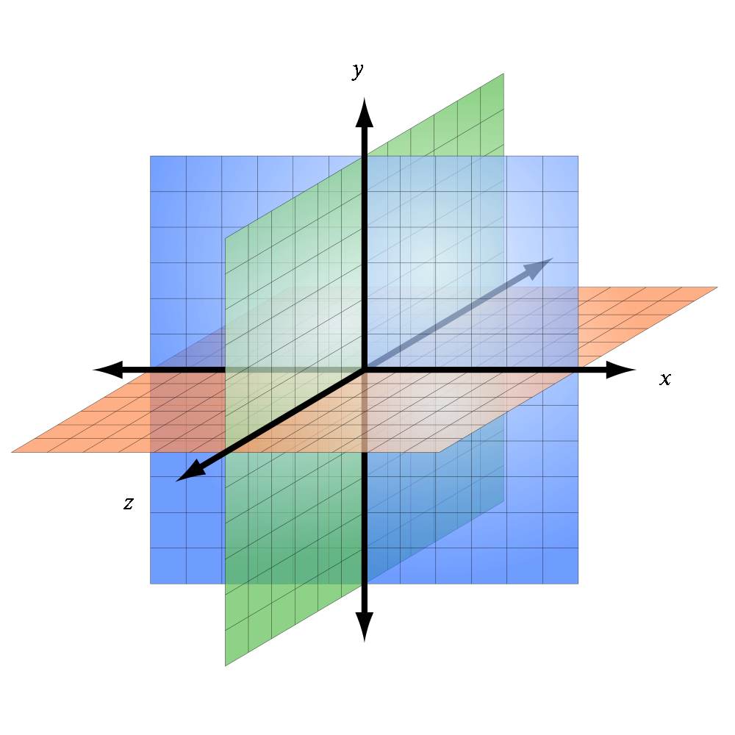
OpenGL Coordinate System
OpenGL ES assumes a coordinate system where (X,Y,Z):
[0,0,0] specifies the center of the frame,
[1,1,0] is the top right corner of the frame, and
[-1,-1,0] is bottom left corner of the frame

Slide 4
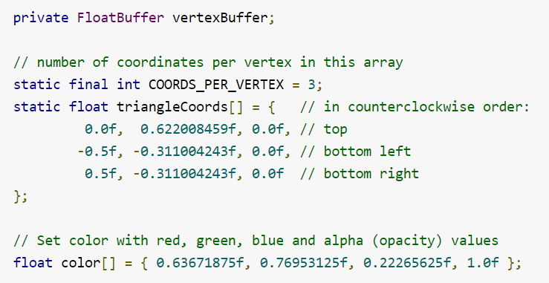
Define a Triangle

Slide 5
Draw Shape : Shaders
Before you do any drawing, you must initialize and load the shapes you plan to draw.
Unless the structure (the original coordinates) of the shapes change during execution, it should be initialized in the onSurfaceCreated() method of the renderer for memory and processing efficiency.
Drawing a defined shape using OpenGL ES 2.0 requires a significant amount of code.
You need to define:
Vertex Shader , Fragment Shader , and
Program - An OpenGL ES object that contains the shaders you want to use for drawing one or more shapes

Slide 6
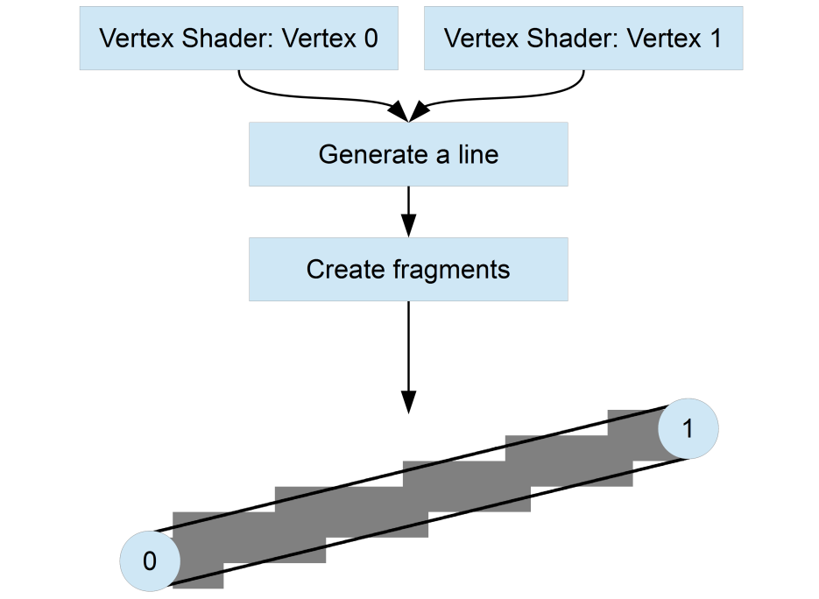
Shaders
Vertex Shader
OpenGL ES code for rendering the vertices of a shape.
Fragment Shader
OpenGL ES code for rendering the face of a shape with colors or textures.
A fragment is a small, rectangular area of a single color, analogous to a pixel on a computer screen.
Generating Fragments (Rasterization)
Notes:
Once the final colors are generated, OpenGL will write them into a block
of memory known as the frame buffer, and Android will then display this
frame buffer on the screen.

Slide 7
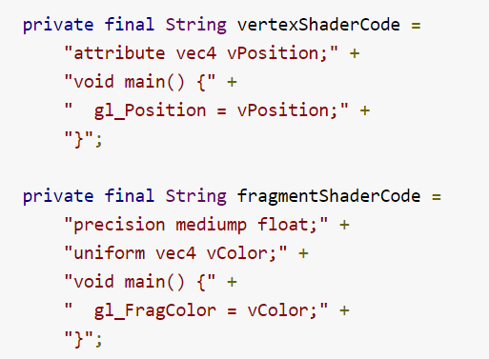
Shaders Example
You need at least one vertex shader to draw a shape and one fragment shader to color that shape.

Slide 8
Shaders (Cont.)
Shaders contain OpenGL Shading Language (GLSL) code that must be compiled prior to using it in the OpenGL ES environment.
In order to draw your shape, we do the following:
Compile the shader code,
Add them to a OpenGL ES program object, and then
Link the program.
Do this in your drawn object’s constructor, so it is only done once.

Slide 9
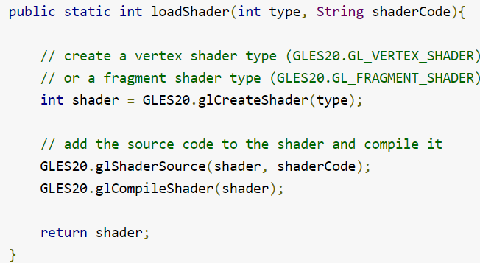
Compiling Shader (In Renderer)

Slide 10
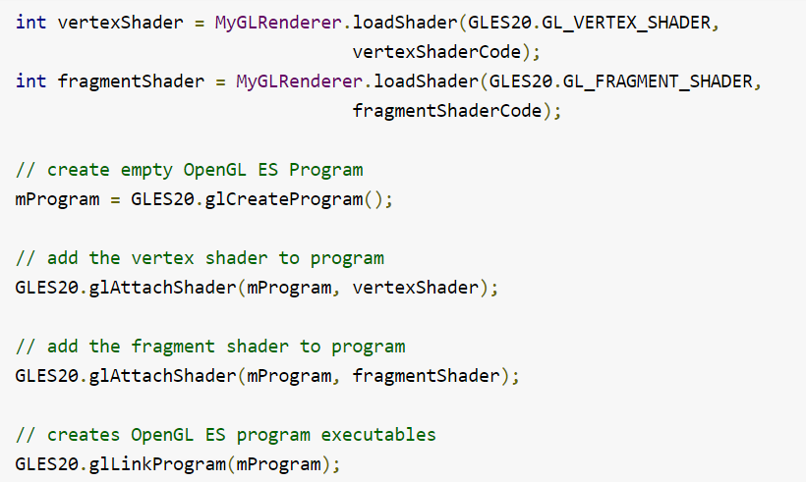
Adding and Linking Shaders

Slide 11
Draw Shape: Final Step
At this point, we are ready to add the actual calls that draw your shape.
Since drawing options can vary by shape, it's a good idea to have your shape classes contain their own drawing logic.
Create a draw() method for drawing the shape that:
sets the position and color values to the shape’s vertex shader and fragment shader, and then
executes the drawing function.
Finally, call the draw() method from within your renderer’s onDrawFrame() method.

Slide 12
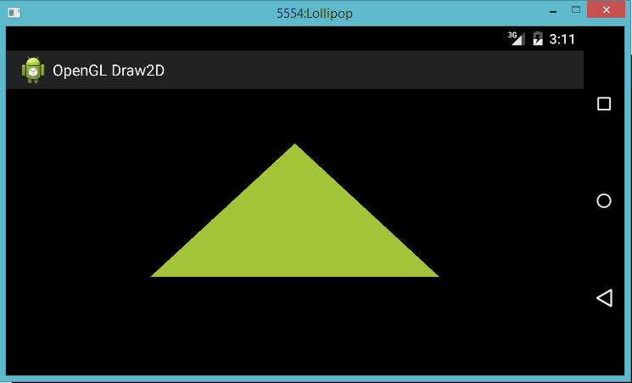
Final Output

Slide 13
Responding To Touch Events

Slide 14
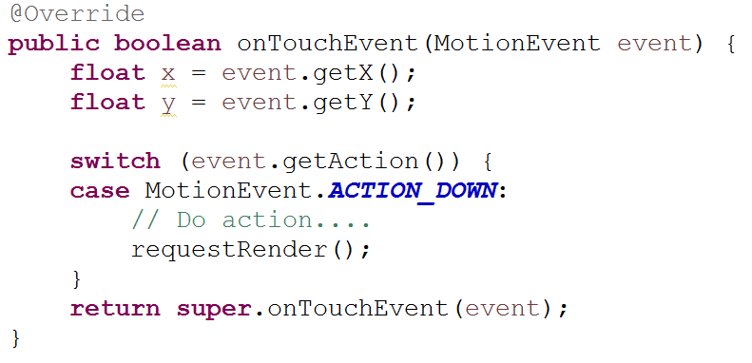
Touch Events
OpenGL ES applications can interact with touch event by expanding the implementation of GLSurfaceView to override the onTouchEvent() to listen for touch events.

Slide 15
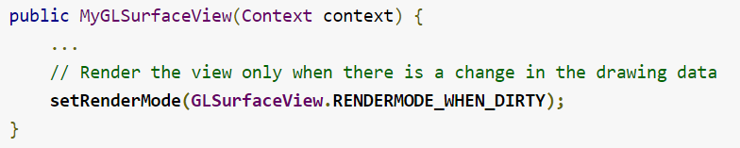
Touch Events (Cont.)
Calls requestRender() to tell the renderer that it is time to render the frame.
For efficiency, request that the renderer only redraw when the data changes using the setRenderMode() method.

Slide 16

Give it a try…
How can we draw the triangle based on user clicks for vertices??!

Slide 17

See you Next Lab

